Slide 1
C/C++ Programming in a UNIX Environment CS 3377
Bhanu Kapoor, PhD Department of Computer Science
University of Texas, Dallas, TX
bhanu.kapoor@utdallas.edu
Notes Week 01

Slide 2
Week 01 Agenda
Course Overview
Text Book
Course Contents Overview
Schedule
Grading
Introduction to OS and UNIX
Getting Access to a Linux Machine
Getting Started with C

Slide 3
Reading for Week 01
Chapter 1 Unix System Overview from Advanced Programming in the UNIX Environment by Stevens and Rago
Recap Chapters 2-4 from C for Programmers with an Introduction to C++. by Harvey Deitel and Paul Deitel.
All books for the course are available online & free via UTD Library => eBook
=> Safari)

Slide 4
Introduction
□ Advanced programming techniques utilizing procedural and object oriented programming in a UNIX environment. Topics include basic UNIX concepts, file input and output, implementation of strings, and dynamic memory allocation/management. Design and implementation of a comprehensive programming project is required. Prerequisite: (CE 2336 or CS 2336 or TE 2336) with a grade of C or better or equivalent. (Same as SE 3376) (3-0) S

Slide 5
Pre-req: CS2336
□ Computer Science II (3 semester credit hours) Further applications of programming techniques, introducing the fundamental concepts of data structures and algorithms. Topics include recursion, fundamental data structures (including stacks, queues, linked lists, hash tables, trees, and graphs), and algorithmic analysis. Includes comprehensive programming projects. Programming language of choice is Java. Prerequisite: CE 1337 or CS 1337 or TE 1337 with a grade of C or better. Prerequisite or Corequisite: CE
2305 or CS 2305 or TE 2305 with a grade of C or better.
(Same as CE 2336and TE 2336) (3-0) S

Slide 6
CS 1337
□ Computer Science I (3 semester credit hours) Review of control structures and data types with emphasis on structured data types. Applies the object-oriented programming paradigm, focusing on the definition and use of classes along with the fundamentals of object- oriented design. Includes basic analysis of algorithms, searching and sorting techniques, and an introduction to software engineering. Programming language of choice is C/C++. Prerequisite: CS 1336 with a grade of C or better or equivalent. (Same as CE 1337 and TE 1337)
(3-0) S

Slide 7
Textbook
□ A Practical Guide to Linux® Commands, Editors, and Shell
Programming, Third Edition. Mark G. Sobell. Prentice Hall.
© 2012. ISBN-10: 0-13-308504-X. ISBN-13:
9780133085044 (Available online & free via UTD Library =>
eBook => Safari)
□ Lecture Notes and additional materials will also be provided in electronic format

Slide 8
Recommended
Advanced Programming in the UNIX® Environment, 3e.
W. Richard Stevens and Stephen A. Rago. Addison- Wesley. © 2013. ISBN-10: 0-321-63773-9. ISBN-13: 9780321637734 (Available online & free via UTD Library
=> eBook => Safari
C for Programmers with an Introduction to C++. by Harvey Deitel and Paul Deitel. © 2013 Prentice Hall ISBN-10: 0-13-346206-4. ISBN-13: 978-0-13-346206-7 (Available online & free via UTD Library => eBook => Safari)

Slide 9
Additional Books
Unix® and Linux® System Administration Handbook, Fourth Edition, Video Enhanced Edition. by Evi Nemeth; Garth Snyder; Trent R. Hein; Ben Whaley. © 2010 Prentice Hall. ISBN-10: 0-13-148005-7. ISBN-13: 978- 0-13-148005-6 (Available online & free via UTD Library
=> eBook => Safari)
Unix Systems Programming: Communication, Concurrency, and Threads. Kay A. Robbins; Steven Robbins. © 2003 Prentice Hall. ISBN-10: 0-13-042411-
0. ISBN-13: 978-0-13-042411-2 (Available online & free
via UTD Library => eBook => Safari)
Gaddis, Starting Out with C++ From Control Structures through Objects (with Access) 8th edition. ISBN-10: 0133796337 • ISBN-13: 9780133796339. (7th edition is OK, 0132576252)

Slide 10
Course Objectives
Ability to use the UNIX operating system interactively as a
user (commands)
Ability to express algorithmic solutions using shell scripting (utilities)
Ability to understand and use regular expressions
Ability to use the UNIX programming environment (editor, compiler and linker)
Ability to understand UNIX processes (creation and control)
Ability to perform input/output of binary files
Ability to use inter-process communication (pipes, sockets and signals)
Ability to understand the UNIX file system
Ability to understand and use version control system

Slide 11
Course Overview:
Fundamentals of C and C++ Programming
Structured Program Development in C
Functions
Pointers
File Processing
Classes, Objects, and Object-Oriented Programming
with C
UNIX System Overview
UNIX System Architecture
UNIX Fundamentals
Editors and Remote Login
Mobaxterm/Putty
Emacs, Vim, Editor of your choice

Slide 12
Course Overview:
Bash Shell Scripting
Definition and Functions of a Shell
Simple Scripts
Regular Expression and Pattern Matching
Programming with Borne and Borne-again Shell
Working with random number
PERL Scripting
PERL Basics
Variables and Lists
Hashes and Arrays
Control Statements, Loops, File Processing
Programming with PERL

Slide 13
Course Overview
Python Programming
Python Basics
Variables and Lists
Hashes and Arrays
Control Statements, Loops, File Processing
Programming with Python
Sed and Awk
Version Management

Slide 14
Class Schedule
Online, M-F
You are expected to participate regularly in the weekly discussions
Weekly discussions account for 10% of the course grades
Exams will be on campus, and location information along with date and time will be announced in the course.

Slide 15
Grading
In-Class Work, Assignments, Quizzes, Projects, Weekly Discussions: 30%
Weekly Discussions: 10%
Midterm Exam 1 : 30%
Final Exam: 30%
UTD Location for Exams: It will be announced.

Slide 16
Week 01 Agenda
Course Overview
Text Book
Course Contents Overview
Schedule
Grading
Introduction to OS and UNIX
Getting Access to a Linux Machine
Getting Started with C

Slide 17
Introduction to OS
□ What are the key functions of an operating system such as UNIX?

Slide 18
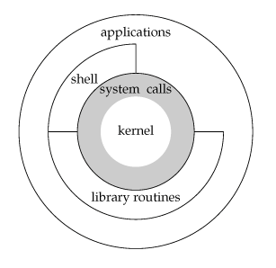
Unix Architecture

Slide 19
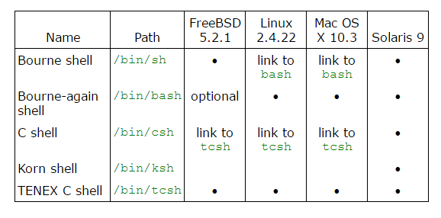
Shells Used with UNIX

Slide 20
Week 01 Agenda
Course Overview
Text Book
Course Contents Overview
Schedule
Grading
Introduction to OS and UNIX
Getting Access to a Linux Machine
Getting Started with C

Slide 21
Experimenting with UNIX/Linux: Options
You must have access to a Linux Machine
Remote login to a UTD Linux Account
You can use MobaXterm software to remote log into UTD Linux Machines (cs1linux
Or
Install a Linux Virtual Machine on Microsoft Windows or Apple OS X
Virtual Machine Software: VirtualBox, VMWare
Linux OS: Ubuntu, Red Hat, …
You must have access to a Linux machine; Mobaxterm or Virtual Machine or physical access to the machine is your choice. You can also use other means like SSH via Putty if you are already used to it or any other remote connection software.

Slide 22
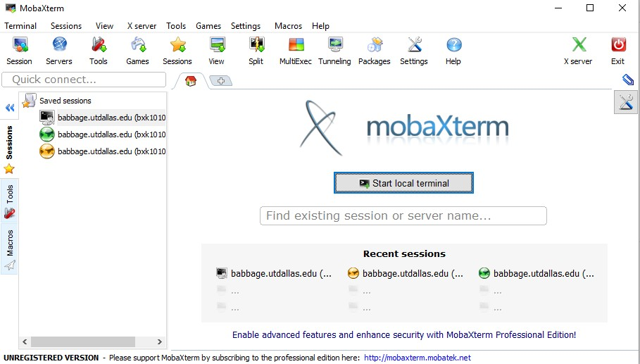
MobaXterm: Remote Option 1
Download an install MobaXterm
http://mobaxterm.mobatek.net/
Use SSH session to log into UTD machines: cslinux1.utdallas.edu or cslinux2.utdallas.edu using your UTD netid and password

Slide 23
Virtual Machine: Remote Option 2
Download and install VirtualBox virtual machine software and install Ubuntu Linux Machine in it.
Next set of slides show the process for getting a Linux Virtual machine.

Slide 24
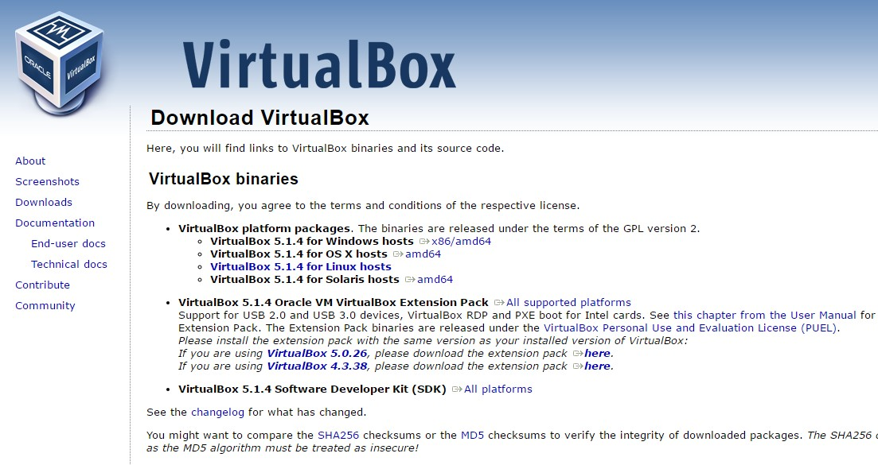
Download VirtualBox
https://www.virtualbox.org/wiki/Downloads

Slide 25
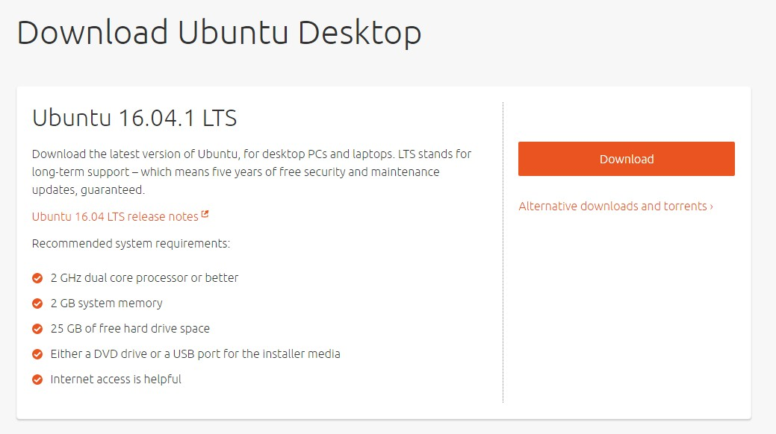
Download Ubuntu Linux
http://www.ubuntu.com/download/desktop

Slide 26
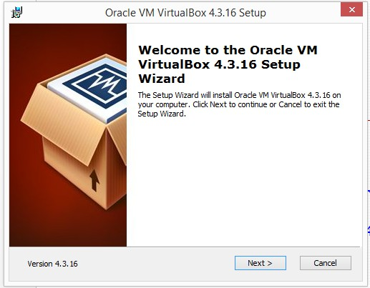
Installing VirtualBox

Slide 27
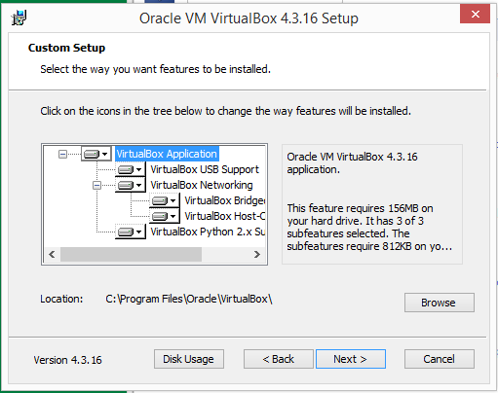
Installing VirtualBox

Slide 28
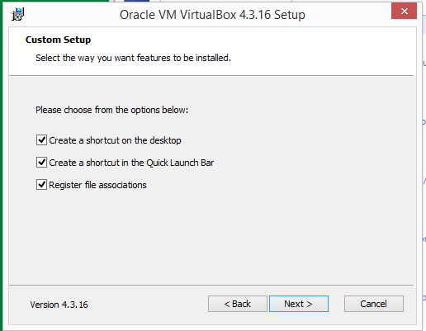
Installing VirtualBox

Slide 29
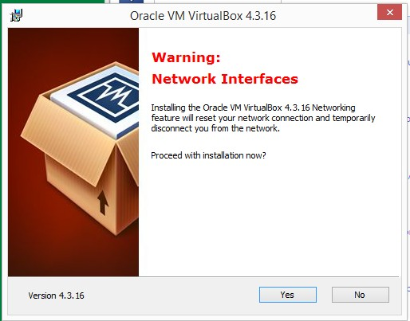
Installing VirtualBox

Slide 31
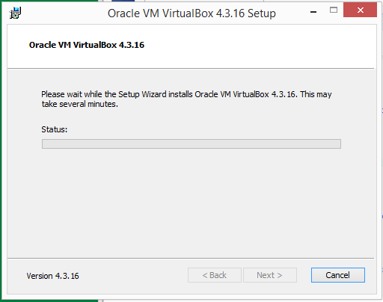
Installing VirtualBox
31
Click Yes to queries and Install

Slide 32
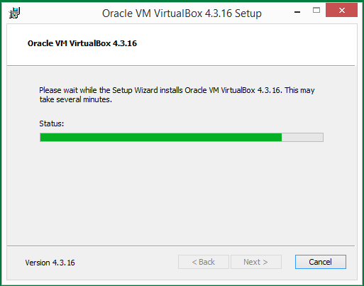
Installing VirtualBox

Slide 33
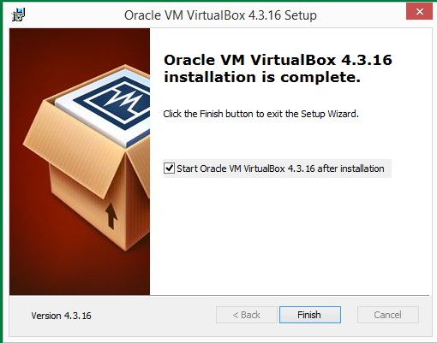
Installing VirtualBox

Slide 34
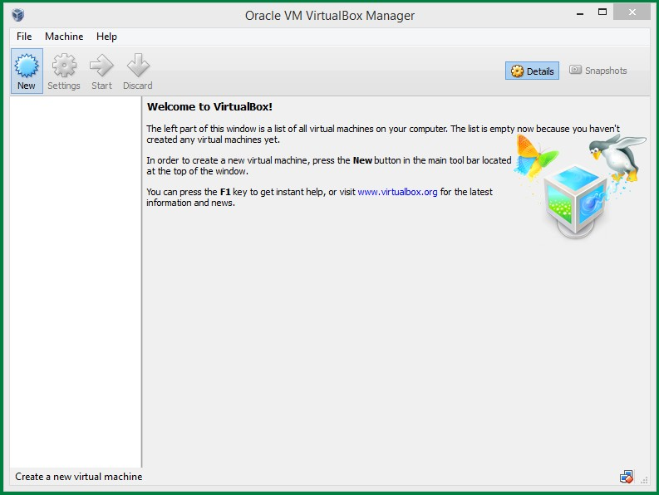
Creating a Virtual Machine

Slide 35
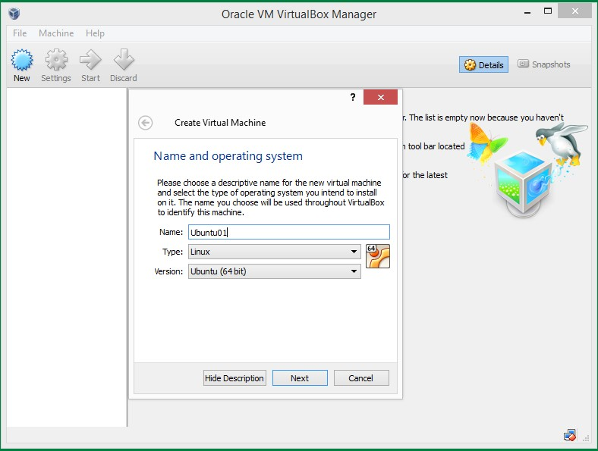
Creating a Virtual Machine

Slide 36
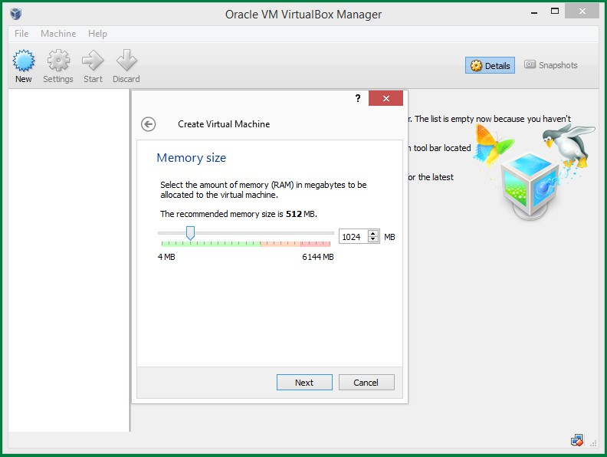
Memory Size for Virtual Machine

Slide 37
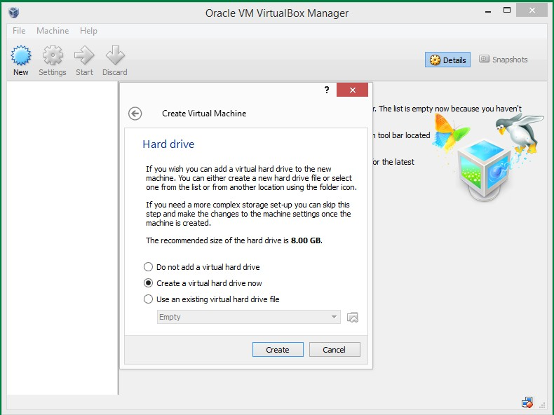
Hard Drive Creation

Slide 38
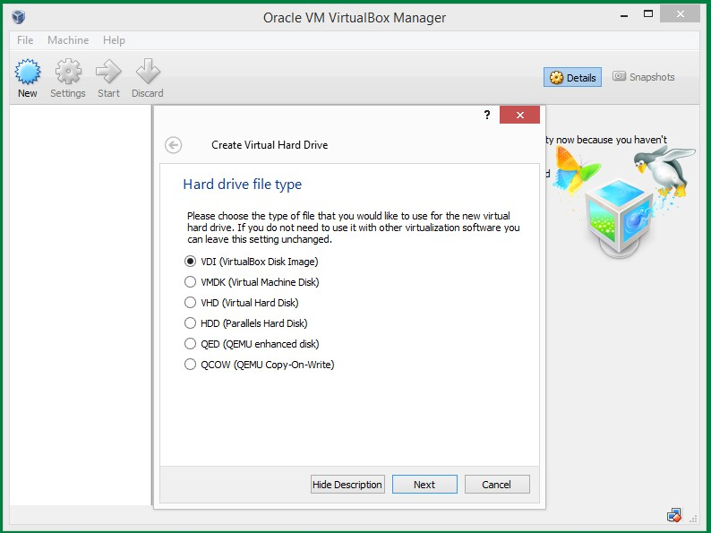
Hard Drive File Type Selection

Slide 39
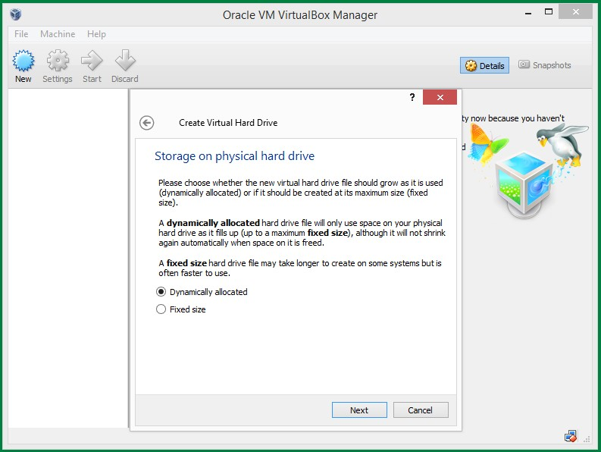
Storage Allocation Type

Slide 40
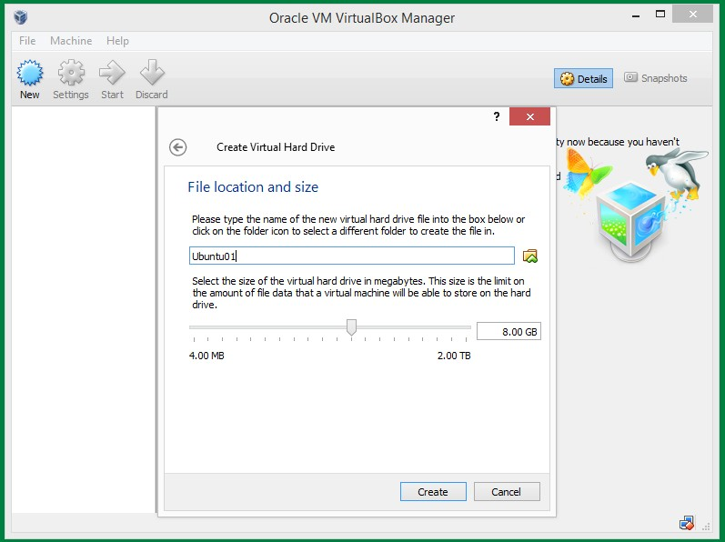
Hard Drive Size for Virtual Machine

Slide 41
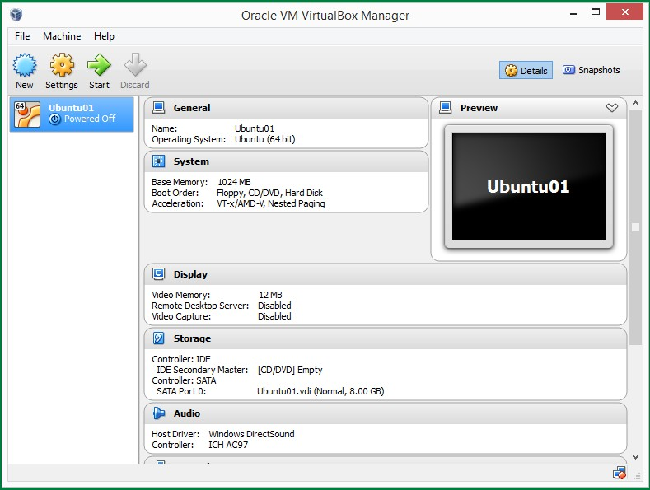
Ready to Install Linux

Slide 42
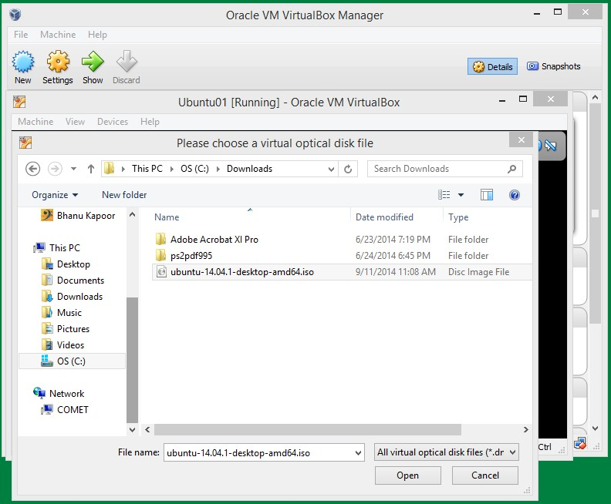
Select Downloaded Ubuntu .iso File

Slide 43
Setting Up Linux Machine
Go through the queries from Ubuntu to configure and set up your Linux Virtual Machine
Somewhere it asks if OK to erase drive, it is referring to the virtual hard drive that you created as part of setting up VirtualBox virtual machine. It’s OK to erase that virtual drive.

Slide 44
Week 01 Agenda
Course Overview
Text Book
Course Contents Overview
Schedule
Grading
Introduction to OS and UNIX
Getting Access to a Linux Machine
Getting Started with C

Slide 45
Getting Started
All Knowledge is either declarative or imperative!
Declarative: statements of fact
Square root x of y is a number s.t. y = x*x
Imperative: recipes for deduction
Computer does two things only:
It performs calculations
It remembers the results of those calculations

Slide 46
Getting Started
Declarative: statements of fact
Square root x of y is a number s.t. y = x*x
Imperative: recipes for deduction
Heron of Alexandria was first to document a way to
computer square root
Method:
Start with a guess g
If g*g is close enough to x, stop and return g
Otherwise create new guess g = g + x/g and go back to the previous step

Slide 47
Getting Started with C
Computer does two things only:
It performs calculations
It remembers the results of those calculations
C program consists of functions and variables
Functions specify calculations
Variables store results
C has a special function: main()
All C programs begin executing at main()
main() call other functions to do its job

Slide 48
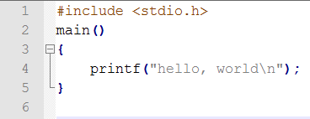
Hello, World! In C
What is #include?
What is main()?
What are enclosed between {}
What is printf? What is \n?
How do you compile this program? $ cc hello.c
Examples from Kernighan & Richie: The C Programming Language
48

Slide 49
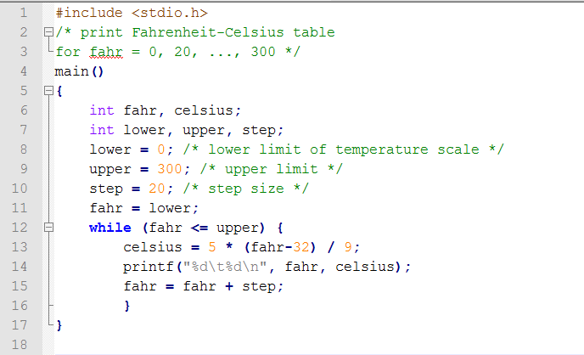
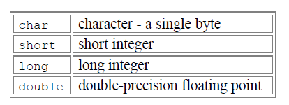
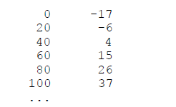
C Program to Convert ⁰F to ⁰C: v1

Slide 50
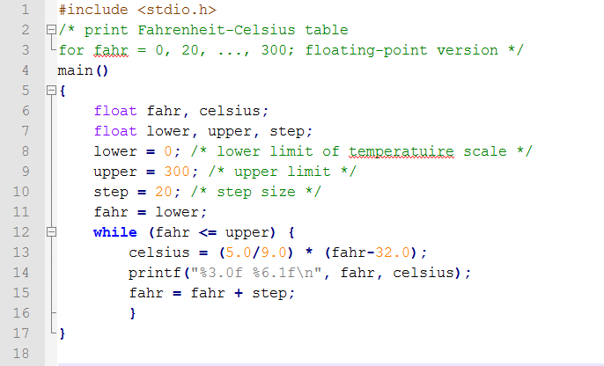
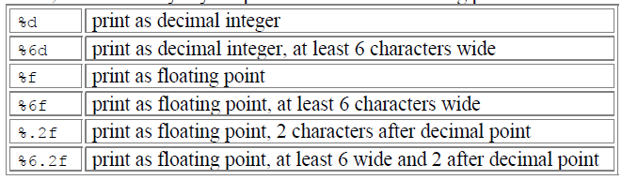
C Program to Convert ⁰F to ⁰C: v2

Slide 51
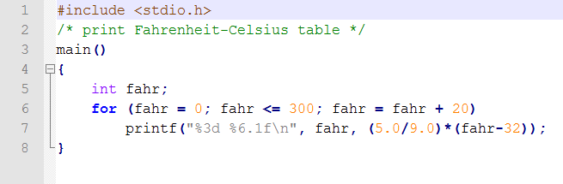
C Program to Convert ⁰F to ⁰C: v3

Slide 52
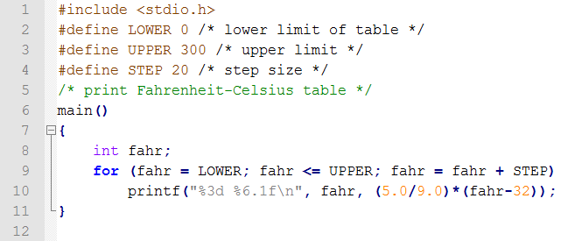
C Program to Convert ⁰F to ⁰C: v4

Slide 53

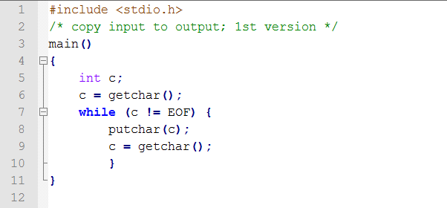
C Program to Copy Files

Slide 54
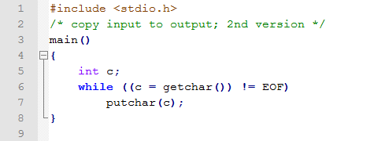
C Program to Copy Files: v2
./a.out < file1 > file2

